Slide 1

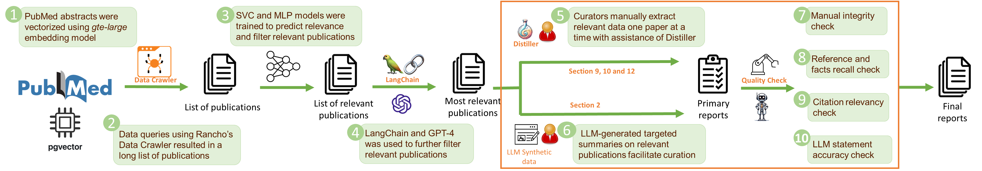
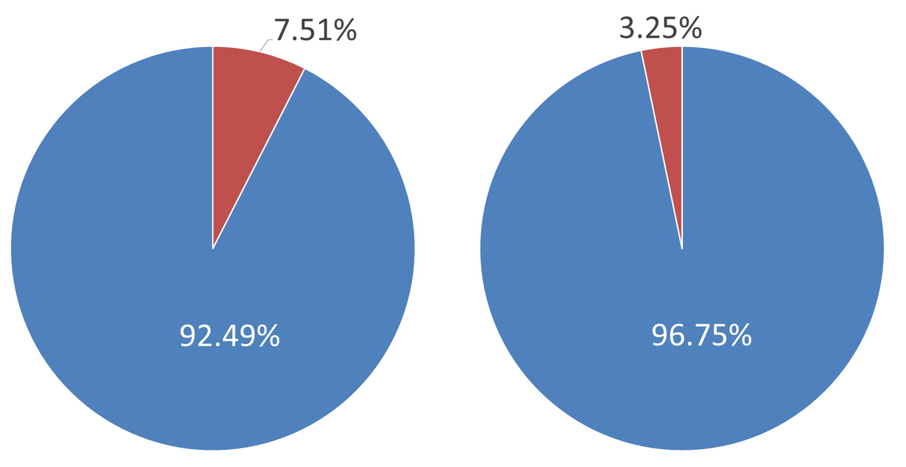
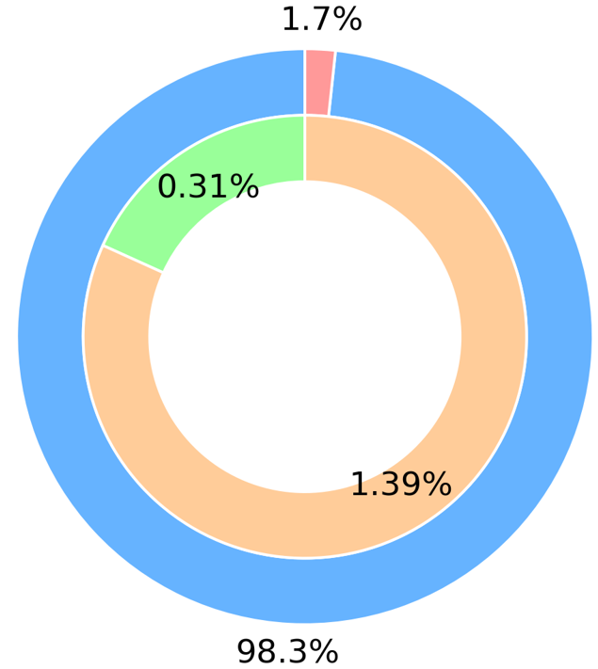
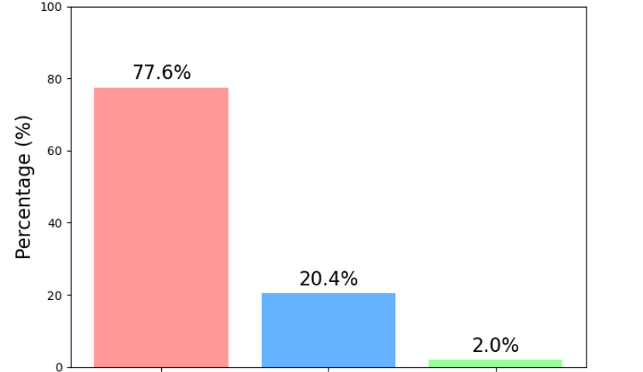

Evaluation of LLM-based and Manual Approaches for Biomarker Data Extraction
Oleg Stroganov¹, Bing Zhou¹, Kelly Shipkowski², Scott S. Auerbach²
¹ Rancho BioSciences, PO Box 7208, Rancho Santa Fe, CA 92067
² Division of Translational Toxicology, NIEHS, RTP, NC 27709
Abstract Number 3570
Background
Methods
The Division of Translational Toxicology (DTT) at the National Institute of Environmental Health Sciences (NIEHS) investigates environmental factors affecting human health through toxicity biomarker identification. While traditional methodologies have proven valuable, they fall short in comprehensively characterizing toxicological effects through transcriptional changes. This study presents a systematic evaluation of methods for extracting and summarizing toxicological biomarker data from scientific literature.
Reports generated by domain experts with or without LLM assistance for information search and distillation. Reports cover topics including 1. Gene expression dysregulation in association with toxicities in tissue of interest (section 2) or in other tissues (section 12); 2. Upstream regulators (section 9); 3. Mechanistic toxicity for gene-tissue pairs (section 10).
Assessment of quality focusing on 1. Consistency across curators; 2. Reference relevancy; 3. Factual statement accuracy.
For fact-based recall check, curated statements were decomposed into individual facts using claude-3.5-sonnet, which were then clustered based on similarity. The clustering process involved using semantic embeddings to filter out significantly different facts and iteratively comparing remaining fact pairs using GPT-4o-mini.
Results
Conclusions
Reference Recall Rate Check
Data Relevancy Check
Factual Accuracy Check
Our findings demonstrate the superior consistency of LLM-assisted curation compared to traditional manual approaches, while highlighting the persistent challenges in standardizing literature-based toxicological data extraction.
The successful application of LLMs in identifying and filtering irrelevant information suggests a promising direction for improving curation quality and efficiency. Future work should focus on refining LLM-based approaches for factual statement comparison and developing more standardized protocols that leverage both automated and expert manual curation methods.
Table 1.
Table 1.
Reference recall rate was much higher for sections supported by LLM-assisted summaries (e.g., Section 2: 63–66%) compared to manually curated sections (e.g., Section 9: 36–38%).
Topics with more complex information (e.g., section 9, mechanism) exhibited higher variation, whereas well-defined topics showed lower variation.
The recall rate based on relevant facts was comparable to that based on PMIDs, suggesting consistency in information extraction across curators.
Table 2.
Curation experience had no significant impact on recall rate. Genes with less available information (Tier 3) exhibited a higher reference recall rate than those with extensive information (Tier 1).
Percentage of relevant data across all sections
Data accuracy assessment by LLM
Section | LLM-supported | Topic complexity | curator -1 | curator-2 more experience | curator-2 | curator -1 | curator-2
/ | / | / | Reference recall rate (PMID) |  |  | Fact-based recall rate
2 | yes | low | 66.2 | 63.0 |  | 51.7 | 44.2
9 | no | high | 36.2 | 38.9 |  | 34.4 | 40.8
10 | no | medium | 40.6 | 40.2 |  | 37.6 | 37.0
12 | no | medium | 39.8 | 39.2 |  | 36.8 | 38.1
% Relevancy
Accurate statements defined by LLM
Inaccurate statement defined by LLM
% Irrelevancy
Accurate statement verified by manual review
Inaccurate statement verified by manual review
The inner pie shows the breakdown of the 1.7% inaccurate statements identified by LLM.
Percentage of irrelevant statements per section
Breakdown of false inaccuracies identified by LLM
curator-1: three independent curators with less experience
curator-2: three independent curators with more experience
An LLM was used to verify the accuracy of extracted data by referencing the abstract of each publication. The LLM method effectively facilitated data accuracy assessment with high precision. Instances of false inaccuracies identified by the LLM were rare and primarily resulted from the absence of full-text access.
Table 2.
gene tier | gene | curator – 1 | curator – 2
1 | Mgmt | 40.8 | 43.3
2 | Cpt1b | 44.3 | 44.3
3 | Phlda3 | 52.1 | 48.3
Both AI-assisted and manual quality check (QC) confirmed high data relevancy to each section's specific topic. Sections curated with LLM assistance exhibited data relevancy comparable to those curated manually.
Evidence in paper full text
Gene alias not recognized
Other reasons

